Slide 1
Joint Training Asset Recovery: recent developments and best practices in asset recovery and the management of physical and digital assets in the Euro-Mediterranean region

Slide 2
Training Objectives
Examine different approaches to asset recovery and confiscation
Provide an overview of the fundamental technology that enables cryptocurrency
Develop competency in cryptocurrency seizure and confiscation
Develop skills in presenting digital evidence in court
Provide an introduction to the opportunities for international cooperation towards effective asset recovery

Slide 3
Training Overview
Session 1
Legal and institutional frameworks for effective asset recovery and confiscation
Session 2
Cryptocurrency Fundamentals for Prosecutors and Judges
Session 3
Planning for Digital and Physical Asset Seizure
Session 4
Cryptocurrency Search, Seizure and Custody
Session 5
Presenting Electronic Evidence in Asset Recovery Proceedings
Session 6
Introduction to International Cooperation in Asset Recovery

Slide 4
Terminology for Asset Recovery
Assets
Tracing Freezing
Seizure
Management realise
Confiscation
Forfeiture Asset Sharing
Non Conviction Based (NCB) Asset Recovery
Civil Forfeiture

Slide 5
The Asset Recovery Process
Identification of Criminal Assets
International Cooperation
Seizure
Freezing
Confiscation
Victim Compensation
-Asset Sharing
-Asset Re-use
M
A
N
A
G
E
M
E
N
T
Law Enforcement
Judicial Authorities

Slide 6
Legal and Institutional Frameworks for Asset Recovery and Confiscation Comparative Approaches: EU and South Partner Countries Session 1

Slide 7

Legal and Institutional Frameworks for Asset Recovery and Confiscation Comparative Approaches: EU and South Partner Countries
Asset recovery aims to deprive criminals of the proceeds of crime and disrupt criminal activities.
Although jurisdictions share this objective, the legal and institutional frameworks supporting confiscation measures vary across regions.
Understanding these frameworks is essential for:
⚖️ Effective Confiscation Proceedings
🤝 International Cooperation
🌏 Cross-border Recovery of Criminal Assets

Slide 8
International Legal Framework for Asset Recovery
Asset recovery is supported by several key international instruments, including:
These instruments establish global standards for freezing, seizure, confiscation, and international cooperation in asset recovery.
United Nations Convention against Corruption (UNCAC) – Chapter V on Asset Recovery (Articles 31, 54, 55, 57)
United Nations Convention against Transnational Organized Crime (UNTOC) (Articles 12, 13, 14)
United Nations Convention on Combating Cybercrime (UNCC) (Articles 40, 41, 42, 43)
Financial Action Task Force Recommendations (FATF) – Confiscation and Provisional Measures (Recommendations 3, 4, 30, 31, 32, 37, 38)

Slide 9

Sources of Asset Recovery Law
Domestic asset recovery systems generally rely on multiple legal sources:
Criminal legislation, providing general rules for confiscation of proceeds and instrumentalities of crime
Specialised legislation, addressing offences such as money laundering, corruption, terrorism, or cybercrime
Regional legal instruments, facilitating cooperation between neighbouring jurisdictions
Procedural rules, governing seizure, freezing, and confiscation measures
Together, these sources form the legal basis for asset recovery proceedings at the national level.

Slide 10
Regional Legal Framework for Asset Recovery
Regional instruments also shape national asset recovery systems.
These conventions complement international instruments and support the development of national asset recovery frameworks in several South Partner countries.
European Union (EU)
Directive 2024/1260 on Asset Recovery and Confiscation
League of Arab States (LAS)
Arab Convention against Corruption (2010)
Arab Convention on Combating Transnational Organized Crime (2010)
Regulation 2018/1805 on the mutual recognition of freezing orders and confiscation orders

Slide 11
National Legal Framework for Asset Recovery
EU Member States
JORDAN
EGYPT
MOROCCO
Penal Code
Criminal Procedure Code
AML Law 80/2002
National confiscation regimes implementing EU directives
Extended confiscation and specialised asset management mechanisms
Combating Money Laundering Law 43-05
Anti-Money Laundering and Counter-Terrorism Financing Law
Anti-Terrorism Law 94/2015
Cybercrime Law 175/2018
National legislation provides the operational legal basis for confiscation and asset recovery.
These laws allow confiscation of proceeds of crime and instrumentalities used in criminal activity.

Slide 12
Institutional Frameworks Supporting Asset Recovery
Effective asset recovery also requires coordinated institutional structures, which includes:
These conventions complement international instruments and support the development of national asset recovery frameworks in several South Partner countries.
European Union
Asset Recovery Offices AROs responsible for asset tracing
South Partner Countries
Judicial Authorities and Specialised Prosecutors
Specialised prosecutors and investigative units
Operational cooperation through Eurojust and Europol
Financial Intelligence Units FIUs supporting investigations
Central Authorities responsible for Mutual Legal Assistance MLA
Financial Intelligence Units
Law Enforcement Agencies conducting financial investigations

Slide 13
Comparative Perspective
Dimension | EU Member States | South Partner Countries
Legal architecture | International, regional and national instruments | International and national frameworks
Confiscation mechanisms | Wider range of tools including extended confiscation | Often conviction-based confiscation
Institutional structures | Asset Recovery Offices and specialised units | Central authorities, prosecutors and courts
Cross-border cooperation | Mutual recognition instruments | MLA-based cooperation
Understanding these differences helps authorities design effective cooperation strategies in asset recovery cases.

Slide 14


Emerging Challenges in Asset Recovery
Modern asset recovery increasingly involves:
Complex Financial Structures and beneficial ownership concealment
Cross-border Movement of Criminal Proceeds
Digital Assets such as cryptocurrencies
These developments create new investigative and evidentiary challenges, which will be explored further in the following sessions.

Slide 15

Alternative Approaches to Targeting Criminal Wealth: Non-Conviction Based Confiscation
Notes:
What is NCB Confiscation?

Slide 16

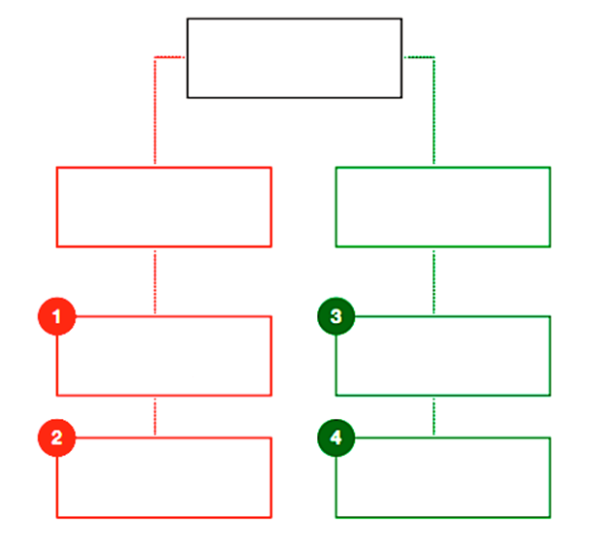
NCB Confiscation Typologies
4 Models
Criminal NCB
Civil NCB
NCB in Criminal Proceedings
Civil Recovery/Preventive Confiscation
Extended Confiscation
Unexplained Wealth

Slide 17
Presenting Electronic Evidence in Asset Recovery Proceedings Practical Guidance for Prosecutors and Judges
Session 5

Slide 18

Presenting Electronic Evidence in Asset Recovery Proceedings
Electronic evidence plays a growing role in investigations involving:
Cybercrime
Cryptocurrency-related Offences
Traditional Crimes.
Civil, Commercial, & Family Justice.
Courts increasingly rely on digital evidence when determining freezing, seizure, and confiscation of criminal assets.

Slide 19
Why Electronic Evidence Matters in Asset Recovery
Electronic evidence can help establish:
the Origin of criminal proceeds
the Movement of assets
the Control of financial accounts or wallets
Links between suspects and illicit funds
This evidence is often essential to support:
Freezing Orders
Seizure Measures
Confiscation Decisions

Slide 20

What is Electronic Evidence?
Electronic evidence refers to:
Information generated, stored, or transmitted in digital form that may be used as evidence in criminal proceedings.
Examples include:
emails and messages
financial transaction records
mobile phone data
cloud storage records
blockchain transaction data

Slide 21

Key Characteristics of Electronic Evidence
Electronic evidence is:
Often invisible to the untrained eye
Volatile and easily altered
Potentially large in volume
Technically complex
Easily copied without degradation
⚠️ Electronic evidence is powerful but fragile.

Slide 22
Sources of Electronic Evidence in Asset Recovery Cases
Common sources include:
Mobile phones and computers
Online banking platforms
Cryptocurrency exchanges
Cloud services
Messaging applications
Blockchain analytics tools
Records held by third-party
Service providers

Slide 23
Lifecycle of Electronic Evidence
Preservation
Authorisation
Collection
Examination and analysis
Preparation for court
Admissibility
Handling electronic evidence typically involves:
Errors in early stages can weaken the evidentiary value later.

Slide 24

Admissibility Principles for Electronic Evidence
Courts evaluating digital evidence should consider:
Authenticity
Integrity
Chain of custody
Legality of collection
Reliability of analysis
These factors determine whether electronic evidence can be admitted and relied upon in court.

Slide 25
Questions Judges Often Ask
Is the evidence authentic?
Has its integrity been preserved?
Is the source reliable?
Is the analysis clear and understandable?
Was the evidence lawfully obtained?

Slide 26
Questions Judges Often Ask
Is the evidence authentic?
Has its integrity been preserved?
Is the source reliable?
Is the analysis clear and understandable?
Was the evidence lawfully obtained?

Slide 27

From Electronic Evidence to Cryptocurrency Evidence
Cryptocurrency investigations rely heavily on digital traces such as:
blockchain transactions
wallet identifiers
exchange records
device evidence
Blockchain data must still be linked to individuals through additional evidence.

Slide 28
Types of Cryptocurrency Electronic Evidence
Wallet Addresses
Transaction Hashes
Exchange KYC Records
Login or IP Logs
Device Evidence showing Wallet Applications
Communications relating to Cryptocurrency Transfers

Slide 29
What Blockchain Evidence Can Show?
Blockchain analysis can reveal:
movement of cryptocurrency between wallets
timing and value of transactions
connections between addresses
transfers to exchanges or services
This information can assist investigators in tracing criminal proceeds.

Slide 30
What Blockchain Evidence Cannot Prove Alone
Blockchain data alone usually cannot prove:
who controlled a wallet
who initiated a transaction
the criminal origin of funds
beneficial ownership
Additional evidence is often required, such as:
device evidence
exchange records
communications
financial investigation

Slide 31
Example: Blockchain Transaction Flow
Predicate Crime
Bank Account
Cryptocurrency Exchange (KYC Account)
Wallet A
Wallet B
Mixer or Bridge
Wallet C
Exchange Cash-Out
Bank Transfer / Asset Purchase

Slide 32
Example: Blockchain Transaction Flow
Possible evidence sources:
🏦 Bank Records
💱 Exchange KYC Information
🔑 Wallet Addresses
📄 Transaction Hashes
📱 Device Evidence
🌐 IP Logs
💬 Communications

Slide 33
Typical Cryptocurrency Laundering Typology
⚠Predicate Crime (fraud / corruption / drug trafficking)
💱 Conversion to Cryptocurrency
🔄 Layering Phase • transfers through multiple wallets • mixing services • cross-chain bridges
💲 Integration Phase • stablecoin conversion • transfers to exchanges • nominee accounts
🏦 Cash-Out • bank transfers • investments • luxury assets

Slide 34
Linking a Suspect to a Cryptocurrency Wallet
👤 Suspect
📱 Device Evidence (wallet application / private keys)
🔑 Wallet Address (blockchain identifier)
⛓ Blockchain Transactions (transaction history)
💱 Exchange Records (KYC / IP logs)
💰 Criminal Proceeds
Attribution usually requires combining several types of evidence together.

Slide 35
Presenting Cryptocurrency Evidence in Court
Good practice includes:
✔ explaining technical findings clearly ✔ using diagrams and transaction timelines ✔ separating data, analysis, and conclusions ✔ presenting expert testimony where necessary ✔ explaining both strengths and limitations of the evidence

Slide 36
Exercise
Investigators identify a wallet linked to an online fraud scheme.
Evidence shows:
victims transferred funds to a crypto exchange account linked to the suspect
funds were transferred to Wallet A and through three additional wallets
a mobile phone seized from the suspect contains a wallet application linked to Wallet A

Slide 37
Interactive Mini Case Exercise
Discussion questions:
1️⃣ What does the electronic evidence establish? 2️⃣ What additional evidence would you require before freezing the assets? 3️⃣ Should investigators be able to compel the suspect to disclose the wallet key or unlock the device? 4️⃣ What legal challenges might arise if biometrics are used to unlock the device?

Slide 38
Five Legal Questions Judges Should Ask in Crypto Asset Recovery Cases
Can the prosecution demonstrate that the suspect controlled the wallet or account involved?
Has the integrity of the electronic evidence been preserved?
Was the electronic evidence lawfully obtained?
Does the blockchain analysis form part of a broader evidentiary chain?
Is the evidence sufficient to justify freezing, seizure, or confiscation?

Slide 39
Key Takeaways
✔ Electronic evidence is central to modern asset recovery investigations
✔ Cryptocurrency investigations rely heavily on digital financial evidence
✔ Blockchain analysis helps trace assets but does not prove ownership alone
✔ Courts must carefully evaluate authenticity, integrity, legality, and context

Slide 40
From Electronic Evidence to Asset Recovery Decisions
💻 Electronic Evidence (devices, emails, logs) ⬇ ⛓ Blockchain Evidence (transaction flows) ⬇ 🔎 Financial Investigation (tracing proceeds) ⬇ 👤 Attribution (link suspect to wallet) ⬇ ⚖ Judicial Evaluation (authenticity & legality) ⬇ 💰 Asset Recovery Decision Freeze • Seize • Confiscate

Slide 41
Introduction to international cooperation in Asset Recovery Session 6

Slide 42
Legal Bases for International Cooperation in Asset Recovery

Slide 43
International Cooperation in Asset Recovery
Criminal proceeds are often transferred, concealed, or invested across multiple jurisdictions, making international cooperation essential.
Asset recovery is an important dimension of international judicial cooperation, alongside:
These mechanisms enable authorities to trace, freeze, confiscate, recover, and return criminal assets across borders.
Mutual Legal Assistance (MLA)
Extradition
Transfer of Sentenced Persons
Joint Investigations
Recognition and Enforcement of Foreign Judicial Decisions

Slide 44
Legal Bases for International Cooperation
International Agreements
Multilateral Agreements
Regional Agreements
Bilateral Agreements
International Comity
Reciprocity
National Legislation
International cooperation in asset recovery may rely on several legal foundations:
Together, these legal bases allow authorities to execute requests for evidence gathering, asset freezing, confiscation, and recovery of criminal assets.

Slide 45
Multilateral Agreements
Multilateral conventions provide the global legal framework for cooperation in asset recovery, such as:
These conventions establish legal bases for MLA, confiscation, asset recovery, and return of assets.
United Nations Convention against Corruption (UNCAC)
United Nations Convention against Transnational Organized Crime (UNTOC)
United Nations Convention on Combating Cybercrime
Chapter IV – International Cooperation (Articles 43–49)
(Articles 12, 13, 14, 18)
Chapter V – International Cooperation (Articles 35–52)
Chapter V – Asset Recovery (Articles 51–59)

Slide 46
Regional Instruments
Regional instruments may facilitate cooperation between states within a particular region.
European Union (EU)
Directive 2024/1260 on Asset Recovery and Confiscation
Arab Region / South Partner Countries
Arab Convention against Corruption (2010)
Riyadh Arab Agreement for Judicial Cooperation (1983)
Regulation 2018/1805 on the mutual recognition of freezing orders and confiscation orders
These instruments enable more direct and efficient cooperation between EU Member States.
These agreements facilitate judicial cooperation, extradition, and enforcement of judicial decisions among Arab states.

Slide 47
Bilateral Agreements
States may also conclude bilateral treaties regulating cooperation in criminal matters.
These agreements may address:
Bilateral treaties often provide more detailed and flexible cooperation frameworks between two states.
Mutual Legal Assistance
Extradition
Recognition and enforcement of judicial decisions
Freezing and confiscation measures
Return or sharing of recovered assets

Slide 48
Cooperation in the Absence of Treaties
International Comity (International Courtesy)
reflects mutual respect between sovereign states
may allow discretionary cooperation between judicial authorities
helps prevent criminals from exploiting jurisdictional gaps
Reciprocity
cooperation granted with the expectation that similar assistance will be provided in return.
Where no treaty exists, cooperation may still occur based on:
These principles may enable cooperation even where formal treaty frameworks are absent.

Slide 49
National Legal Frameworks
Domestic legislation is essential for implementing international cooperation in practice.
National laws may allow authorities to:
Domestic law therefore acts as the operational bridge between international cooperation and practical enforcement.
execute Mutual Legal Assistance requests
recognise and enforce foreign freezing or confiscation orders
freeze or seize assets at the request of foreign jurisdictions
regulate the powers of courts, prosecutors, central authorities, and FIUs.

Slide 50
Formal and Informal Cooperation
International cooperation may occur through both formal and informal channels.
Informal cooperation can help identify assets quickly, while formal cooperation is generally required for evidence admissibility and enforcement measures.
Formal Cooperation
Informal Cooperation
MLA requests
rogatory letters
treaty-based Judicial cooperation
police-to-police cooperation
FIU-to-FIU exchanges
contacts through international networks

Slide 51
Practical Challenges
International cooperation in asset recovery may face challenges such as:
differences in legal systems and confiscation regimes
dual criminality requirements
evidentiary standards
bank secrecy and beneficial ownership issues
delays in executing requests
increasing use of cryptocurrencies and digital assets
Early communication between authorities can significantly improve cooperation outcomes.

Slide 52
Key Takeaways
Asset recovery is a core component of international judicial cooperation
Cooperation may rely on multilateral, regional, and bilateral agreements
In the absence of treaties, cooperation may rely on international comity, reciprocity, and national law
Effective cooperation requires both strong legal frameworks and practical coordination

Slide 53
Regional and International Cooperation Networks & Mechanisms

Slide 54

























































Using CARIN to Trace Assets
61 Members
Poland
Portugal
Romania
San Marino
Serbia
Slovak Republic
Slovenia
South Africa
Spain
Sweden
Switzerland
Thailand
Turkey
Ukraine
United Kingdom
USA
Albania
Andorra
Australia
Austria
Belgium
Bosnia and
Herzegovina
Bulgaria
Canada
Croatia
Cyprus
Czech Republic
Denmark
Estonia
Finland
France
Georgia
Germany
Gibraltar
Greece
Guernsey
Hungary
Iceland
Indonesia
Ireland
Isle of Man
Israel
Italy
Jersey
Kazakhstan
Kosovo
Latvia
Liechtenstein
Lithuania
Luxembourg
Malta
Moldova
Monaco
Montenegro
The Netherlands
North Macedonia
Norway

Slide 55

18 Members of ARIN-SA
(Asset Recovery Inter-Agency Network of Southern Africa)
Angola
Botswana
Comoros
Democratic Republic of the Congo (DRC)
Eswatini
Kenya
Lesotho
Madagascar
Malawi
Mauritius
Mozambique
Namibia
Seychelles
South Africa
Tanzania
Uganda
Zambia
Zimbabwe
18 Members of ARIN-SA
(Southern Africa)
Notes:
55
55
55

Slide 56
24 Members of RRAG (Red de Recuperación de Activos de GAFILAT) Latin-America
Argentina
Bangladesh
Bolivia
Brazil
Chile
Colombia
Costa Rica
Cuba
Dominican Republic
Ecuador
El Salvador
France
Guatemala
Honduras
Kyrgyzstan
México
Nicaragua
Panamá
Papua New Guinea
Paraguay
Peru
Philippines
Spain
Uruguay

Slide 57

31 ARIN-AP Members (Asia Pacific)
1 | Australia | 26 | Thailand
2 | Brunei | 27 | Timor-Leste
3 | Cambodia | 28 | Tonga
4 | China | 29 | Tuvalu
5 | Chinese Taipei | 30 | Vanuatu
6 | Cook Islands | 31 | Vietnam
7 | India
8 | Indonesia
9 | Japan
10 | Kazakhstan
11 | Korea
12 | Kyrgyzstan
13 | Laos
14 | Malaysia
15 | Maldives
16 | Mongolia
17 | Myanmar
18 | Nepal
19 | New Zealand
20 | Pakistan
21 | Palau
22 | Papua New Guinea
23 | Philippines
24 | Singapore
25 | Sri Lanka

Slide 58






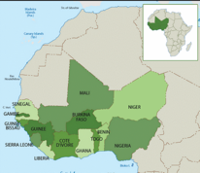











17 ARIN-WA (Western Africa) Members
Liberia
Mali
Mauretania
Niger
Nigeria
Sao Tome & Principe
Senegal
Sierra Leone
Togo
Benin
Burkina Faso
Cape Verde
Gambia
Ghana
Guinea
Guinea-Bissau
Ivory Coast

Slide 59

ARIN-CARIB Asset Recovery Inter-Agency Network
Caribbean (32 Members)
Anguilla | Jamaica
Antigua & Barbuda | Martinique (FR)
Aruba | Montserrat (UK)
Bahamas | Saba (NL)
Barbados | St. Barthelemy (FR)
Belize | St. Eustatius (NL)
Bermuda | St. Kitts & Nevis
Bonaire (NL) | St. Lucia
British Virgin Islands (UK) | St. Maarten (NL)
Canada | St. Martin (FR)
Cayman Islands (UK) | St. Vincent & the Grenadines
Curacao (NL) | Suriname
Dominica | Trinidad & Tobago
Dominican Republic | Turks & Caicos Islands
French Guiana (FR) | USA
Guadaloupe (FR)
Haitia | CARICOM & CFATF
The Caribbean (ARIN-CARIB)
Notes:
59
59
59

Slide 60
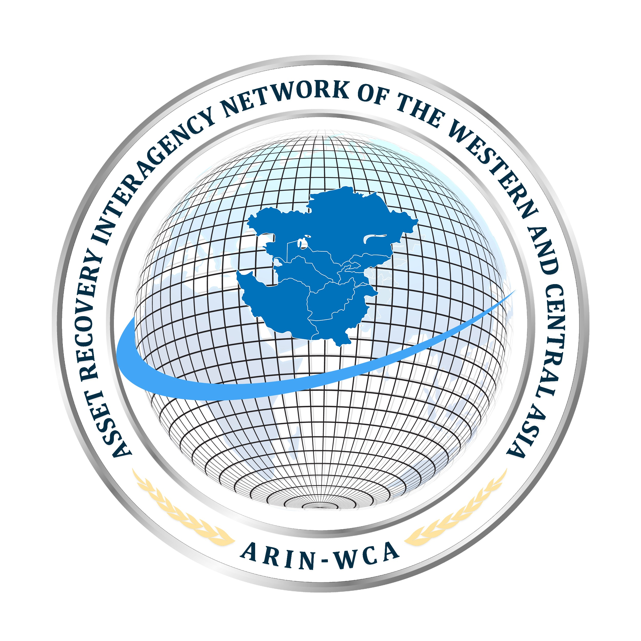
Asset Recovery Inter-agency Network West and Central Asia (ARIN-WCA) 8 Members
Afghanistan
Iran
Kazakhstan
Kyrgyzstan
Pakistan
Tajikistan
Turkmenistan
Uzbekistan

Slide 61
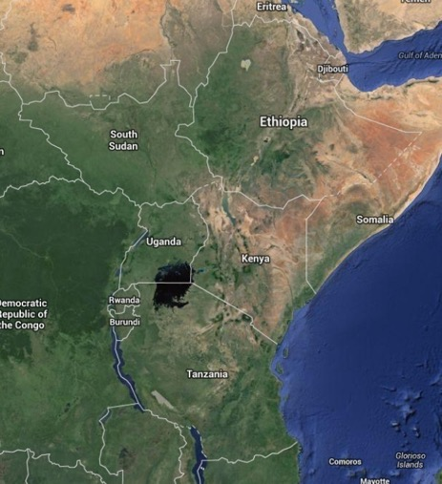

ARIN-EA (East Africa) 8 members
Burundi
Djibouti
Ethiopia
Kenya
Rwanda
South Sudan
Tanzania
Uganda

Slide 62
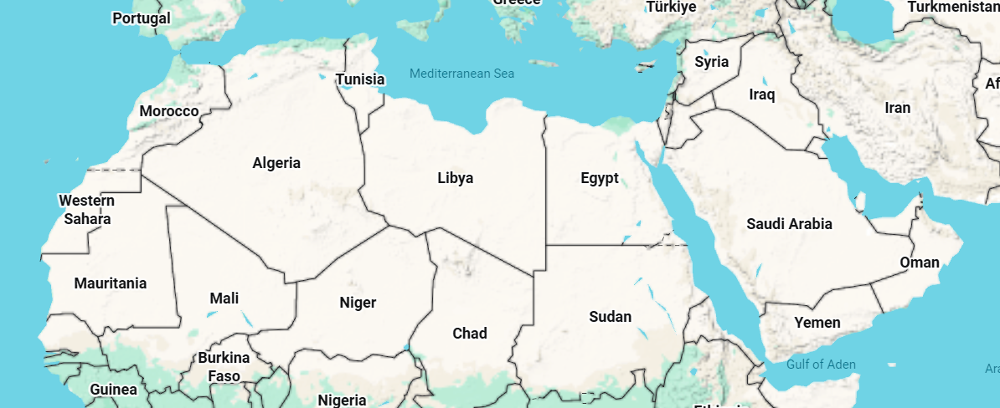
MENA-ARIN (Middle East and North Africa ARIN)
21 members
Gulf Region:
Bahrain, Kuwait, Oman, Qatar, Saudi Arabia (Permanent Secretariat), United Arab Emirates.
Levant & Iraq:
Iraq, Jordan, Lebanon, Palestine, Syria.
North Africa:
Algeria, Egypt, Libya, Mauritania, Morocco,
Tunisia.
East Africa & Red Sea:
Djibouti, Somalia, Sudan, Yemen.
Permanent Secretariat: The network's headquarters is hosted by the Oversight and Anti-Corruption Authority (Nazaha) in Jeddah, Saudi Arabia.
Email: info@nazaha.gov.sa or 980@nazaha.gov.sa
International Phone: +966 11 4420057 (Fax)
WhatsApp: +966 539980980

Slide 63


Asset Recovery Institutional Frameworks
Asset Recovery Offices (AROs)
Asset Management Offices (AMOs)

